Slide 1
Methods

Slide 2
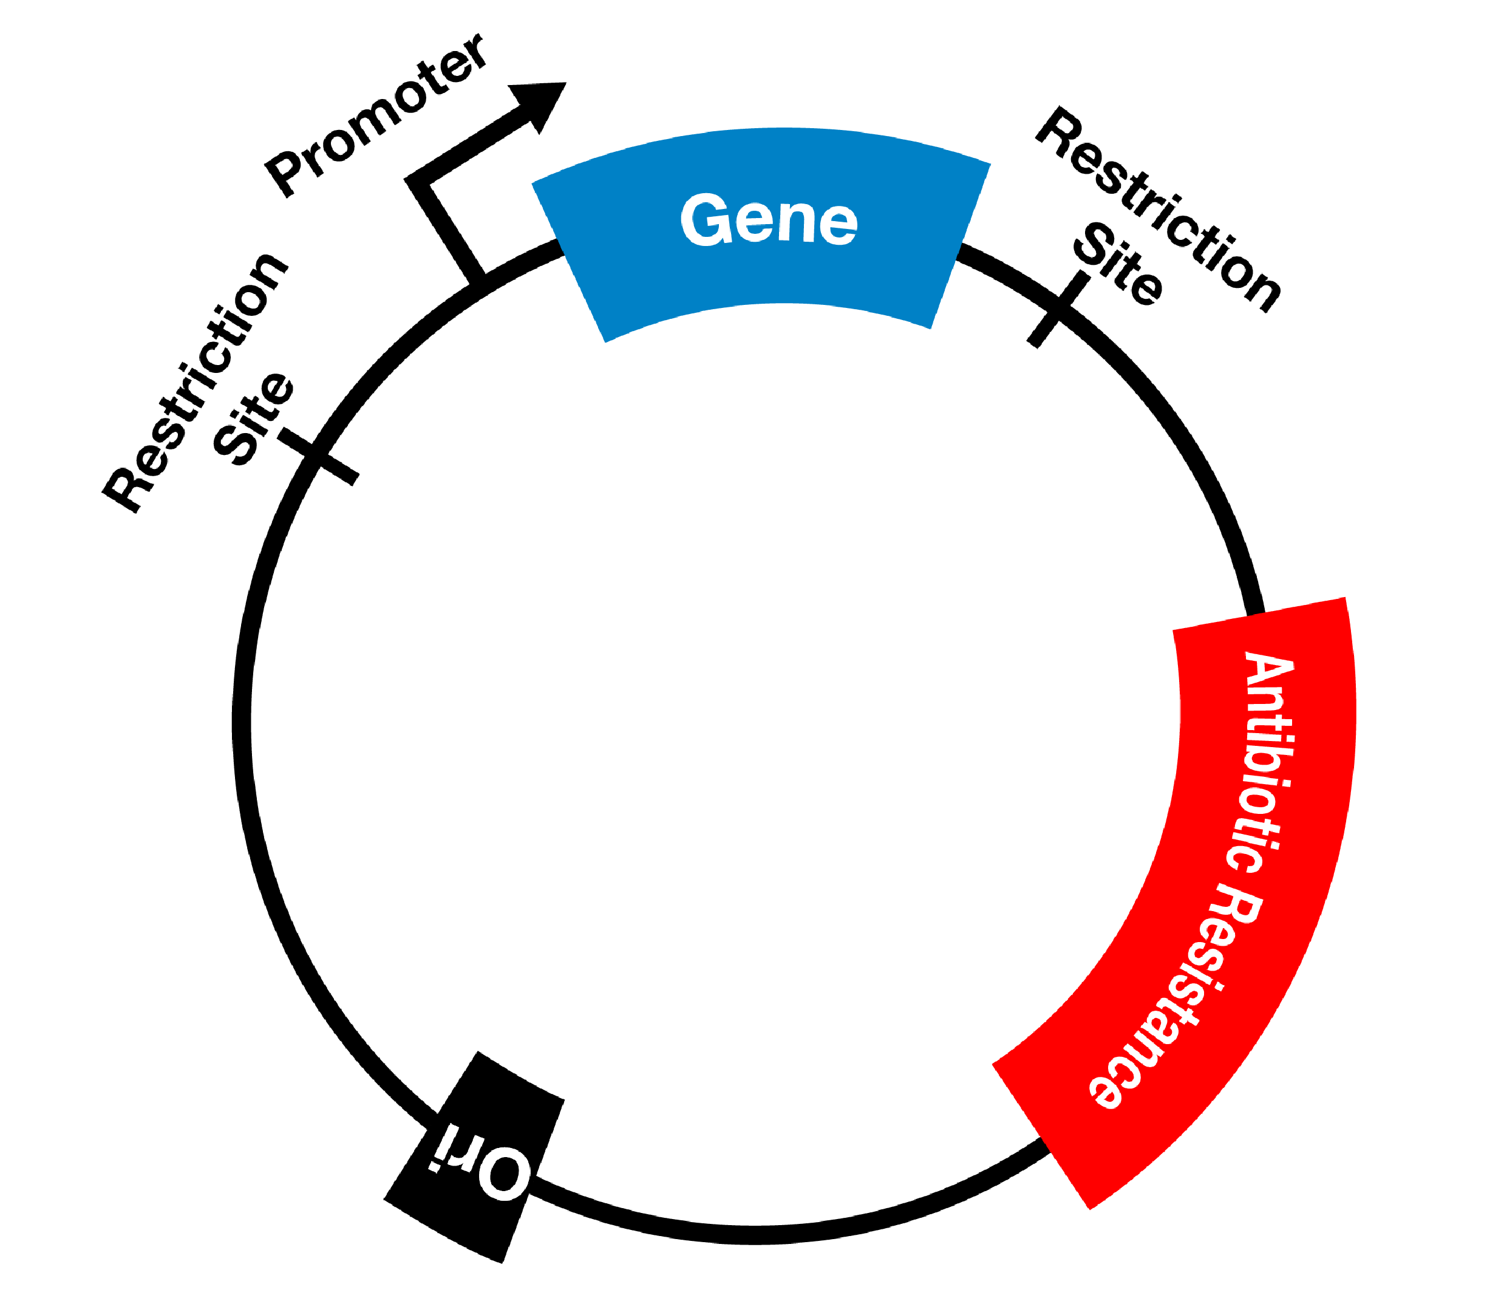
Plasmide construction
Amplification of GLC and TSR through PCR
Cloning into the plant expression vector

Slide 3
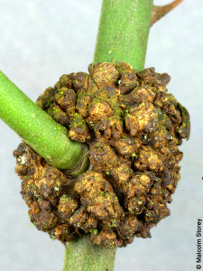
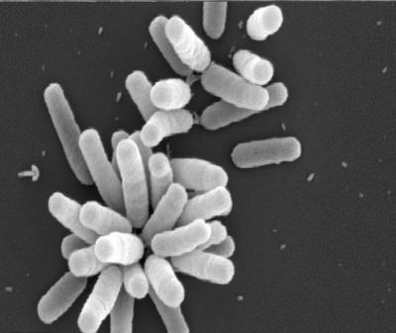
Plant growth and transformation
Transformation of A. thaliana by Agrobacterium tumefaciens.
Growth conditions: -Short day conditions (8h, 16h) -Temperature: 22°C -Light emission: 100 µmol/m^-2*s^-1
CO2 treatments 100 ppm and 2000 ppm

Slide 4
Chloroplast isolation
Isolation: 4 weeks old A. thaliana plants.
Preparation: -Plant material: 5g leaf -50mL grinding buffer -Centrifugation: 1000g for 10min -Resuspension -Centrifugation: 500g for 5 min -Washed

Slide 5
CO2 release from labeled glycolate in chloroplast extracts
Mix of 1µCi [1,2-14C] and 50 µg of chloroplast protein
Absorption of CO2 - 0.5mL tube, containing 0.5M NaOH

Slide 6
Determination of metabolites and chlorophyll contents
Preparation: Freezing of two samples after 4h of illumination
Extraction of sugars with boiling ethanol
Starch determination: - Enzymatic hyrolization
AA determination: → Glycine and Serine - Whole leafs were harvested - Amount of AA was determined with gas chromatographie and MS.

Slide 7
Statistical analysis
Significance determination → Student’s t-test
Tool: Excel (Microsoft)

